Slide 1
Advanced Java

Slide 2
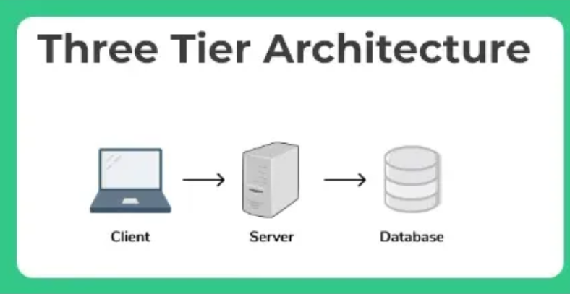
Introduction to Java EE Architecture
Java EE (Java Platform, Enterprise Edition), now known as Jakarta EE, is a set of specifications and APIs used for building enterprise-level, server-side applications in Java. It provides a robust and scalable platform for developing distributed, multi-tiered, and web-based applications.
Multi-Tiered Architecture : Java EE applications are typically organized into the following tiers:
A. Client Tier : Examples: Browsers, mobile apps, standalone Java applications.
B. Web Tier : .Responsible for presentation logic.
Technologies: Servlets, JSP
C. Business Tier :Contains the core business logic of the application.
D. Data Tier : Interacts with relational or NoSQL databases.
Technologies: JPA (Java Persistence API), JDBC (Java Database Connectivity).

Slide 3
Different Types of Servers
1. Web Server : Handles client requests and serves static or dynamic web content.
Provides support for web-tier components like Servlets, JSP, and HTML pages.
2. Application Server : Provides a runtime environment for business logic and server-side components
Manages the entire J2EE application lifecycle, including security, scalability, and transaction management.

Slide 4
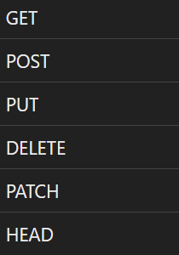
Http Stateless Protocol and its methods
HTTP (Hypertext Transfer Protocol) is a stateless protocol widely used for communication between clients (browsers) and servers on the web.
Stateless: Each HTTP request from the client to the server is independent; the server does not retain any information (state) about previous requests from the same client.

Slide 5
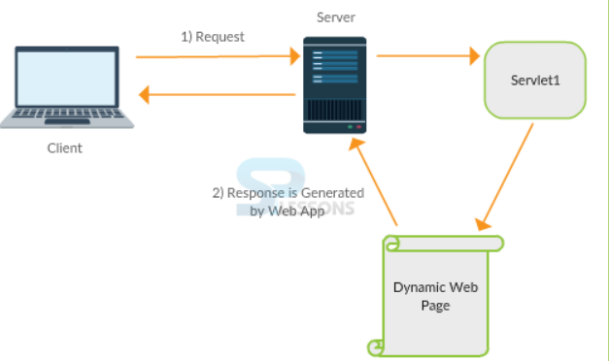
Java Servlet Technology
Java Servlets are a fundamental technology for building web applications in Java. They enable Java applications to process requests from web clients, typically browsers, and generate dynamic responses. Servlets are used to extend the functionality of a web server by providing server-side processing capabilities.
Servlets are part of Java EE (Jakarta EE) and are designed to handle HTTP requests, respond with dynamic content, and provide a basis for more complex applications like e-commerce platforms, online services, and other web applications.

Slide 6
The Model-View-Controller (MVC) Architecture
Model-View-Controller (MVC) Architecture
The Model-View-Controller (MVC) architecture is a widely used design pattern for developing web applications. It separates the application into three interconnected components: Model, View, and Controller. This separation allows for modularity, easier maintenance, and better organization of code.
Model – Data and Logic/code
View – For user display
Controller – Takes the input, processes it and returns the response.

Slide 7
Java EE Containers and Java Application Servers
Java EE Containers and Java Application Servers
In Java EE (Jakarta EE) development, containers and application servers are crucial components that provide the environment for deploying, managing, and running Java applications. These containers are responsible for providing various services like transaction management, security, multi-threading, database connectivity, and more, to ensure that Java applications run efficiently and reliably.
Java EE Containers and Java Application Servers
In Java EE (Jakarta EE) development, containers and application servers are crucial components that provide the environment for deploying, managing, and running Java applications. These containers are responsible for providing various services like transaction management, security, multi-threading, database connectivity, and more, to ensure that Java applications run efficiently and reliably.
What is a Java EE Container : A Java EE Container is a runtime environment that provides a host for Java EE applications and their components (such as Servlets, EJBs, JSPs, and more). The container is responsible for providing services and infrastructure needed to execute the applications and manage their lifecycle. There are two main types of containers in Java EE: Web Container (Servlet Container) : Handles web components such as Servlets and JSP (JavaServer Pages).
It manages the lifecycle of Servlets and processes HTTP requests from clients.
It provides features like session management, request dispatching, and filtering of incoming requests.
Example: Apache Tomcat, Jetty.

Slide 8
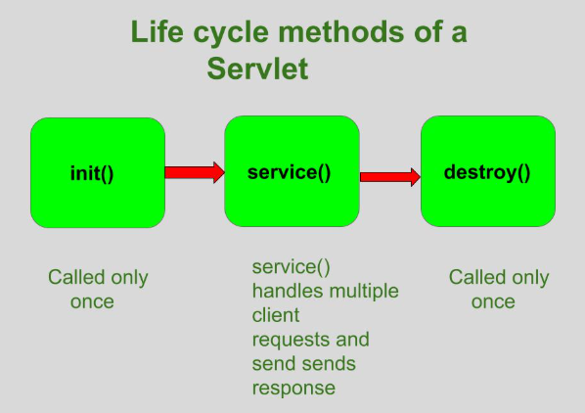
Life Cycle of a Servlet

Slide 9
Requests from the Client Browser
In Java servlets, the requests from the client browser are encapsulated as objects of the HttpServletRequest class. This class provides methods to access request parameters, headers, attributes, and other data sent by the client.
From eclipse --> Change the perspective first --> Window --> Perspective --> J2ee.
Download Tomcat 9 and integrate with the eclipse --> Steps --> Windows --> Preferences --> Server --> Runtime Environment --> Add --> Apache --> Apache 9.0 --> enter the directory of Apache 9 (Not bin directory, installation directory).
Create a project in Eclipse --> File --> Dynamic Web Project --> Enter the project name --> Select Apache Tomcat as the web server --> click on finish.
Add the servlet code under Java Resources --> src/main/java --> MyServlet.java

Slide 10
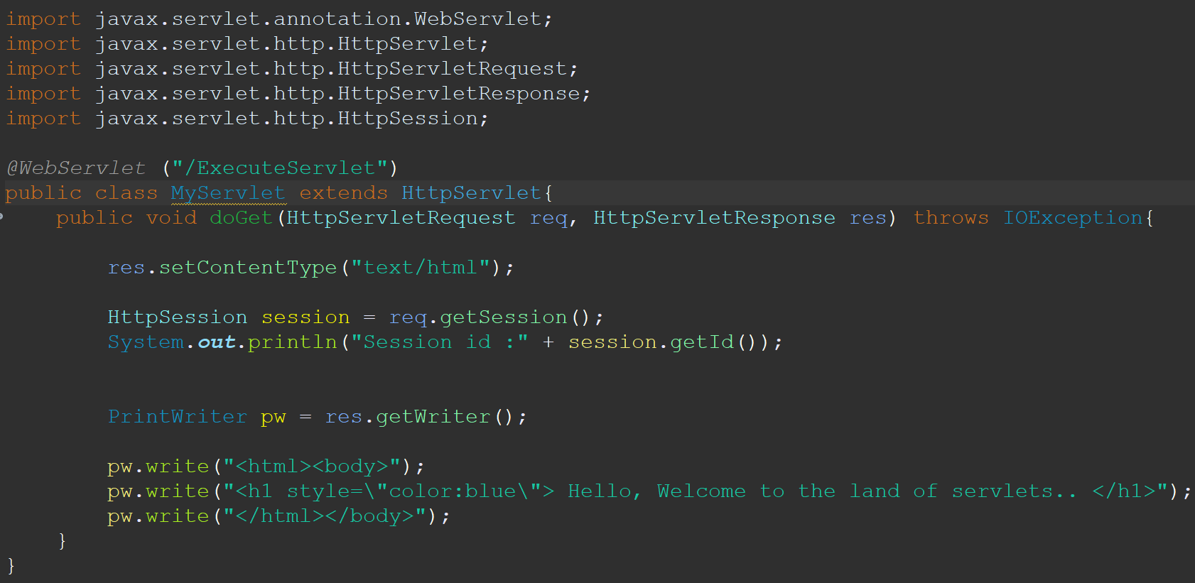
Requests from the Client Browser

Slide 11
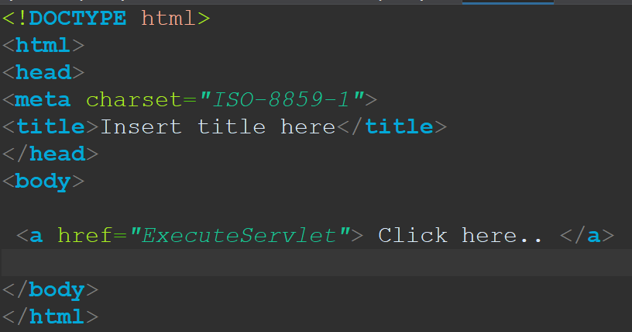
HTML Code :
HTML : Create a html file under webcontent directory. Right click on the html file --> Run As --> Run on Server --> Select the project --> finish.

Slide 12
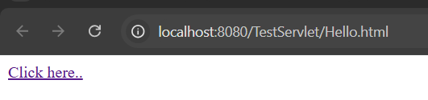
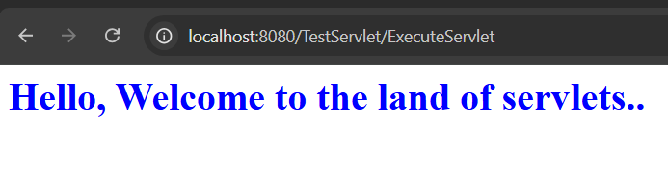
Result of this code shown on browser.

Slide 13
How Form Data Is Sent in an HTTP Request
Form Submission: When a user submits an HTML form, the browser sends an HTTP request to the server. This request contains the form data (i.e., the data entered by the user in the form fields) either as part of the URL (in the case of GET) or in the request body (in the case of POST).
HTTP Methods: There are two common HTTP methods for sending form data:
GET: Form data is sent as query parameters in the URL.
POST: Form data is sent in the body of the request, allowing for larger amounts of data to be sent.

Slide 14
Servlet that Retrieves Form Parameters
Using request.getParameter(“field name”) is retrieved by the servlet.

Slide 15
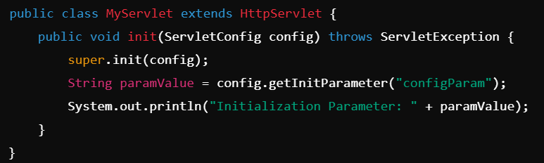
ServletConfig and ServletContext Interfaces
The ServletConfig and ServletContext interfaces are part of the Java Servlet API, and they play key roles in configuring and managing servlets within a Java web application.
ServletConfig Interface : ServletConfig is used to provide configuration information to a single servlet. It is a unique object for each servlet and is created by the servlet container when the servlet is initialized.
Key Responsibilities: Initialization Parameters: It provides access to initialization parameters defined in the web application's deployment descriptor (web.xml) for a specific servlet.
ServletContext Access: It allows access to the ServletContext for the servlet.
Key Methods: String getInitParameter(String name): Retrieves a specific initialization parameter by name.

Slide 16
ServletConfig and ServletContext Interfaces
ServletContext Interface : ServletContext is a global object shared by all servlets in a web application. It provides information about the web application environment and allows servlets to interact with it.
Key Responsibilities: Application-Wide Parameters: Provides access to application-wide initialization parameters.
Resource Management: Allows access to resources (e.g., files) in the web application.
Logging: Offers methods for logging messages.
Attribute Sharing: Enables servlets to share objects across the application through attributes.
Key Methods: String getInitParameter(String name): Retrieves a context-wide initialization parameter by name.
Enumeration<String> getInitParameterNames(): Returns the names of all context-wide initialization parameters.
Object getAttribute(String name): Retrieves an attribute set in the context.
void setAttribute(String name, Object value): Sets an attribute in the context.

Slide 17
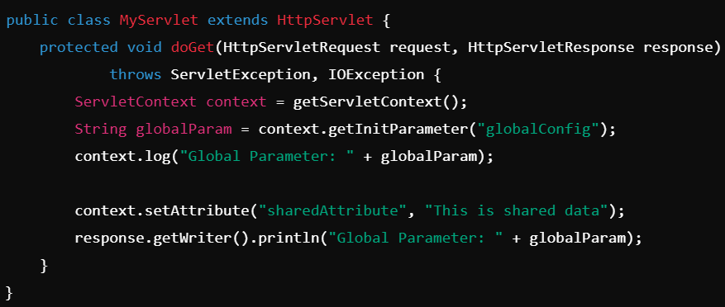
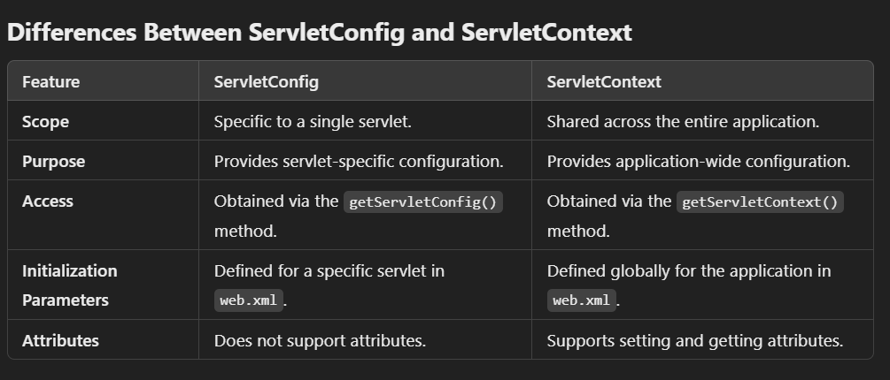
ServletConfig and ServletContext Interfaces

Slide 18
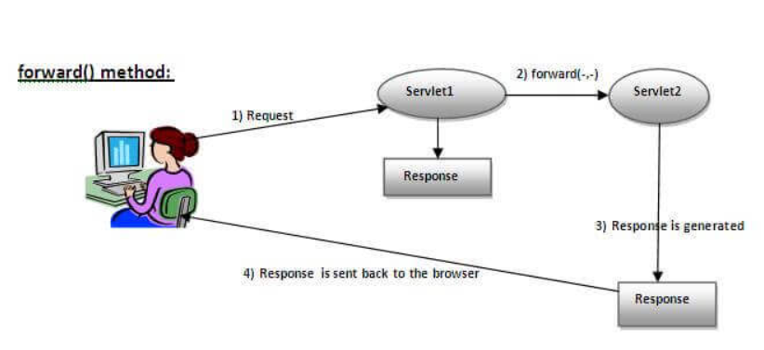
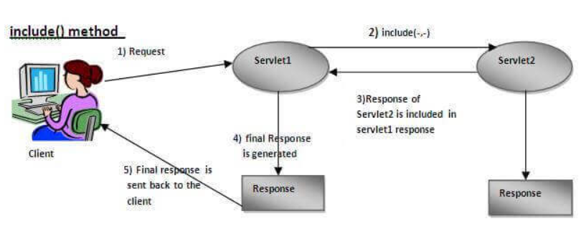
Redirecting using Request Dispatcher
Using Request Disptacher you can send the control to another servlet using forward() method or another servlet can be included in the current servlet using include() method.

Slide 19
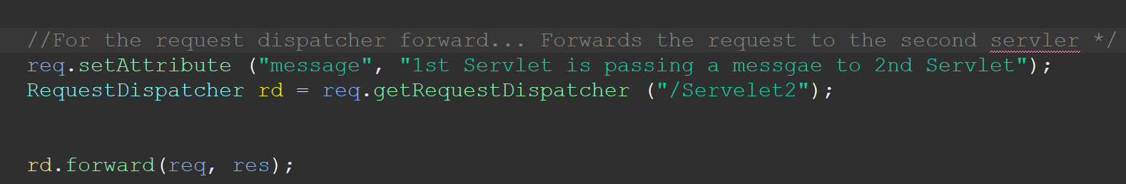
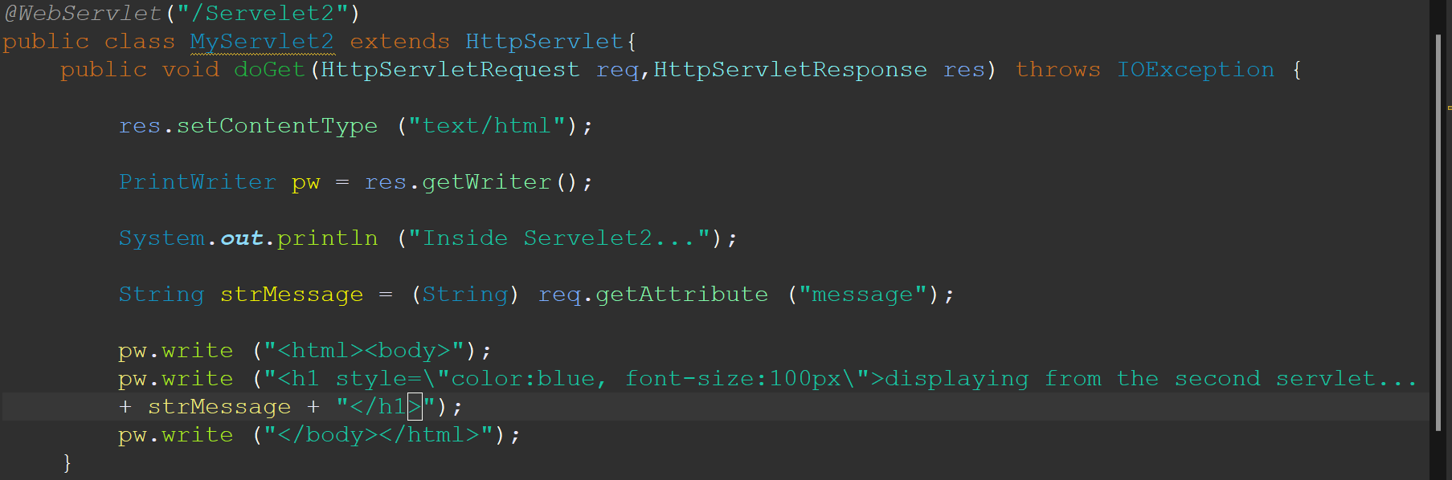
ServletConfig and ServletContext Interfaces
Add the following code in first servlet.
Add the following code in the second servlet.

Slide 20
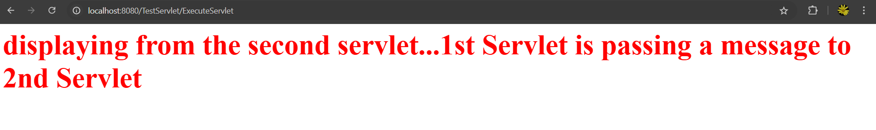
ServletConfig and ServletContext Interfaces
Execute hello.html from webapp folder and you get the following response.

Slide 21

Redirecting using sendRedirect
SendRedirect() --> redirects the front end or client with a specific URL. You are instructing the client to exectute the given URL in the browser.

Slide 22
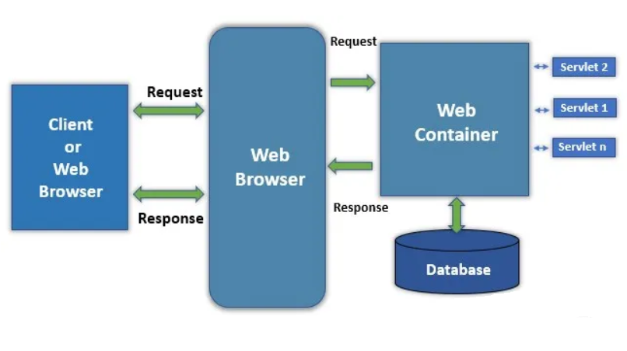
Web Container Request Cycle
The Servlet Web Container Request Cycle defines the life cycle of a request in a Java Servlet environment. This cycle describes how a request from a client (browser) is processed by a servlet and how a response is sent back. Below is a step-by-step explanation:
1. Client Sends a Request
2. Web Server Receives the Request
3. Web Container Processes the Request : Locates and Loads the servlet and
initialized the servlet .
The container creates HttpServletRequest and HttpServletResponse objects. It calls the appropriate Get/POST method and
4. Servlet generates a response.
5. Web Server Sends the Response.

Slide 23
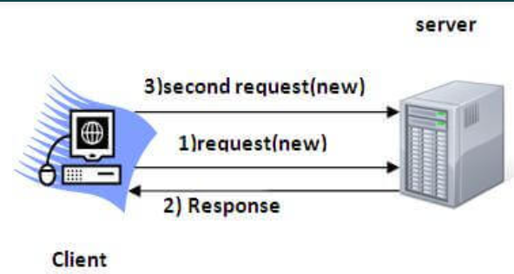
Session Management with 4 ways
Session Tracking is a way to maintain state (data) of an user. It is also known as session management in servlet. Http protocol is a stateless so we need to maintain state using session tracking techniques. Each time user requests to the server, server treats the request as the new request. So we need to maintain the state of an user to recognize to particular user.
HTTP is stateless that means each request is considered as the new request. It is shown in the figure given below:
It provides several benefits that enhance both functionality and user experience:
Maintaining State Across Multiple Requests : HTTP is stateless by nature, meaning that each request is independent and does not carry any information about previous interactions.
Reason for Session Tracking: To maintain a continuous experience, session tracking helps retain the user's data (e.g., login information, preferences) across multiple requests.
Example: In an e-commerce site, the items added to the shopping cart need to persist when the user navigates between different pages.

Slide 24
Session Management with 4 ways
Why use Session Tracking?
To recognize the user It is used to recognize the particular user.
Session Tracking Techniques : There are four techniques used in Session tracking:
Cookies
Hidden Form Field
URL Rewriting
HttpSession

Slide 25
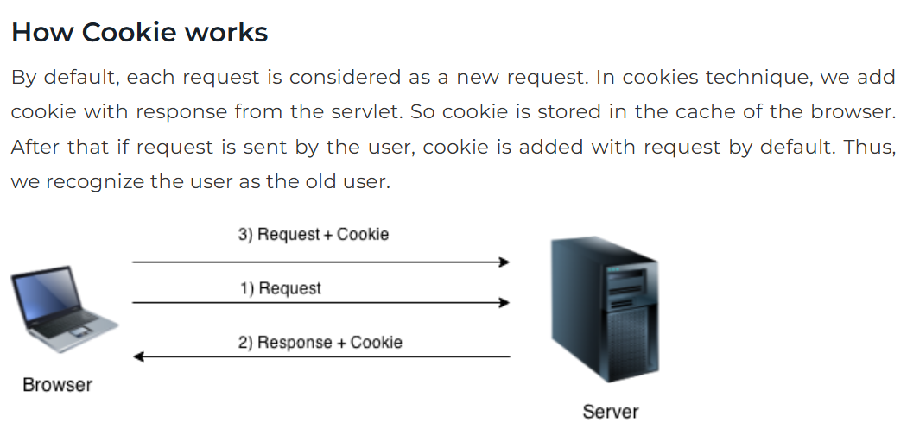
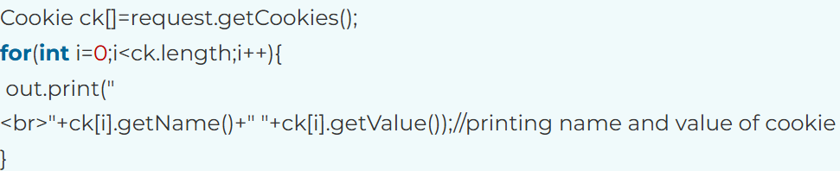
Cookie in servlets.
Cookies in Servlet : A cookie is a small piece of information that is persisted between the multiple client requests.
Create a cookie -->
Rea a cookie -->

Slide 26
Hidden Form Fields in servlets.
In case of Hidden Form Field a hidden (invisible) textfield is used for maintaining the state of an user.
In such case, we store the information in the hidden field and get it from another servlet. This approach is better if we have to submit form in all the pages and we don't want to depend on the browser.
Let's see the code to store value in hidden field.
<input type="hidden" name="uname" value="Charan"> --> This has to given in the html form.

Slide 27
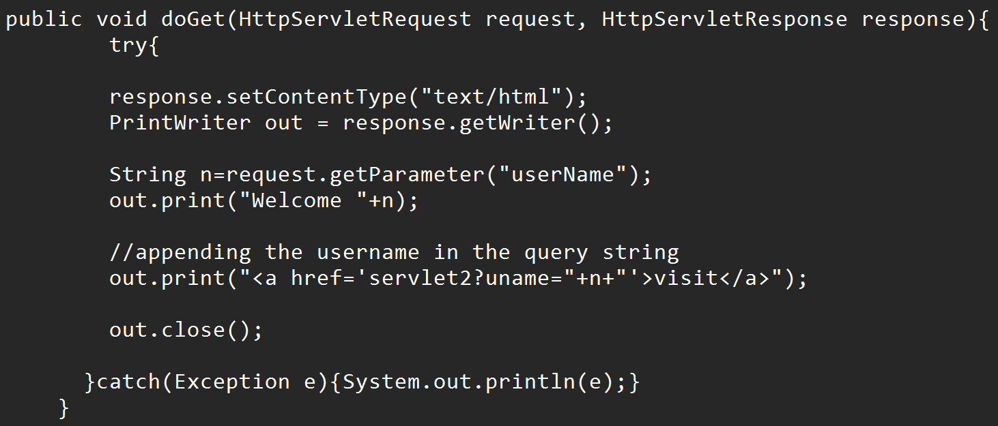
URL Rewriting in servlets.
In URL rewriting, we append a token or identifier to the URL of the next Servlet or the next resource. We can send parameter name/value pairs using the following format:
url?name1=value1&name2=value2&??

Slide 28
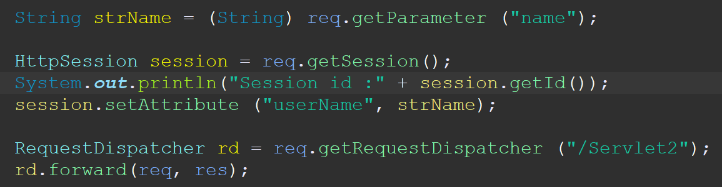
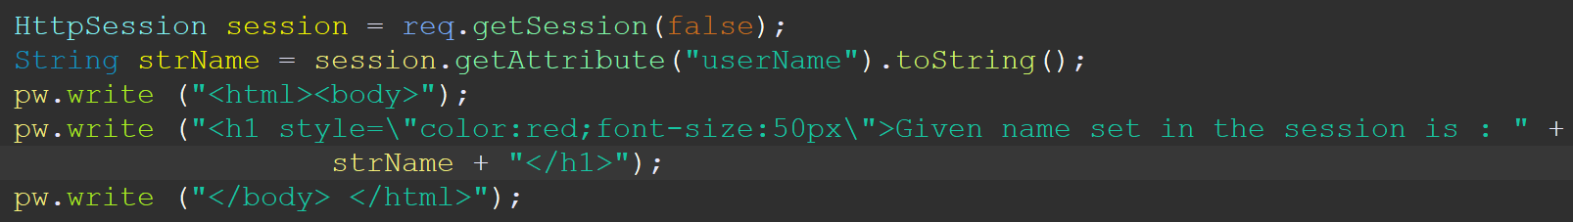
HttpSession interface in servlets.
Container creates a session id for each user.
Request.getSession() will return the session Object for that session. Using that we can set the value in the session by using the function session.setAttribute() and getAttribute() can be used to get the session data.
To set the data in the session -->
To obtain the data from another servlet -->

Slide 29
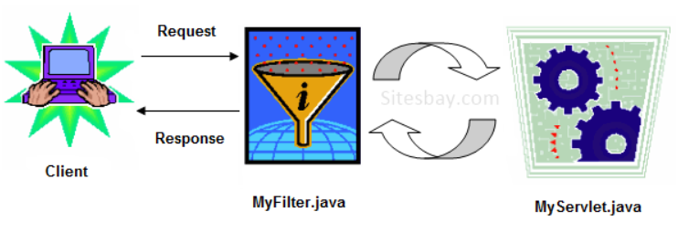
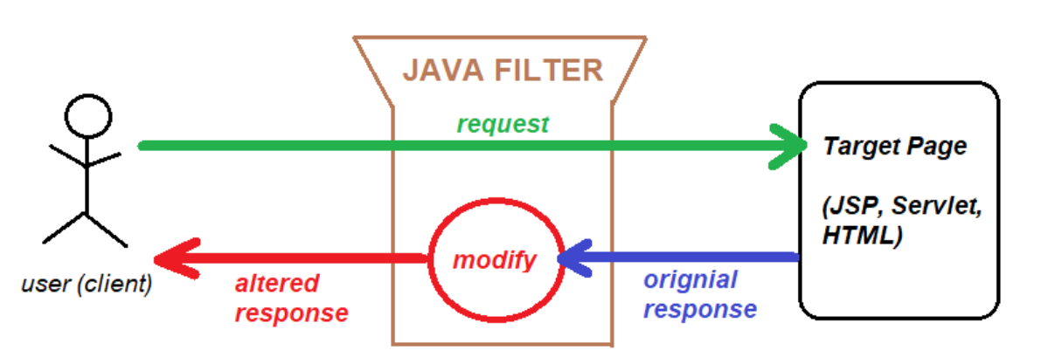
Filter API
The Filter API in Java Servlets allows you to modify requests and responses in a web application. Filters are primarily used for pre-processing or post-processing of requests and responses. They act as reusable components that can transform content or headers, authenticate requests, log activities, compress responses, and much more.

Slide 30
Filter API
Filter Interface: The javax.servlet.Filter interface must be implemented to create a filter.
Filter Initialization: The container initializes the filter by calling its init method. init(FilterConfig config): Called once when the filter is instantiated. It's used for initialization.
Filtering Requests/Responses: Each request and response passes through the filter's doFilter method.. doFilter(ServletRequest request, ServletResponse response, FilterChain chain): This is where the filter logic is implemented. The filter can modify the request/response or pass the request to the next filter or servlet using chain.doFilter(request, response).
Filter Destruction: When the filter is no longer needed, the container calls its destroy method.. destroy(): Called when the filter is taken out of service. Used for cleanup tasks.
Use Cases of Filters :Authentication and Authorization, Logging and AuditinCompression, Compress responses (e.g., using GZIP), Content Transformation: Modify content, like adding headers or changing the body. CORS (Cross-Origin Resource Sharing): Handle cross-origin requests.

Slide 31
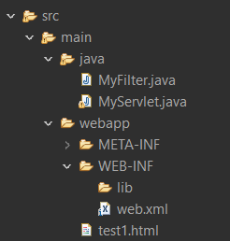
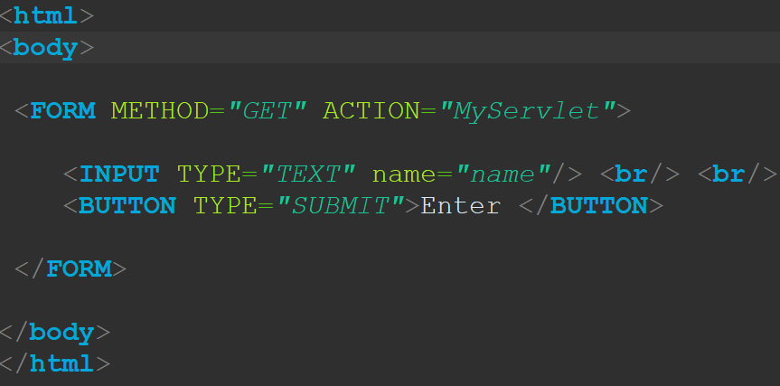
Filter API
Project Structure -->
HTML File -->

Slide 32
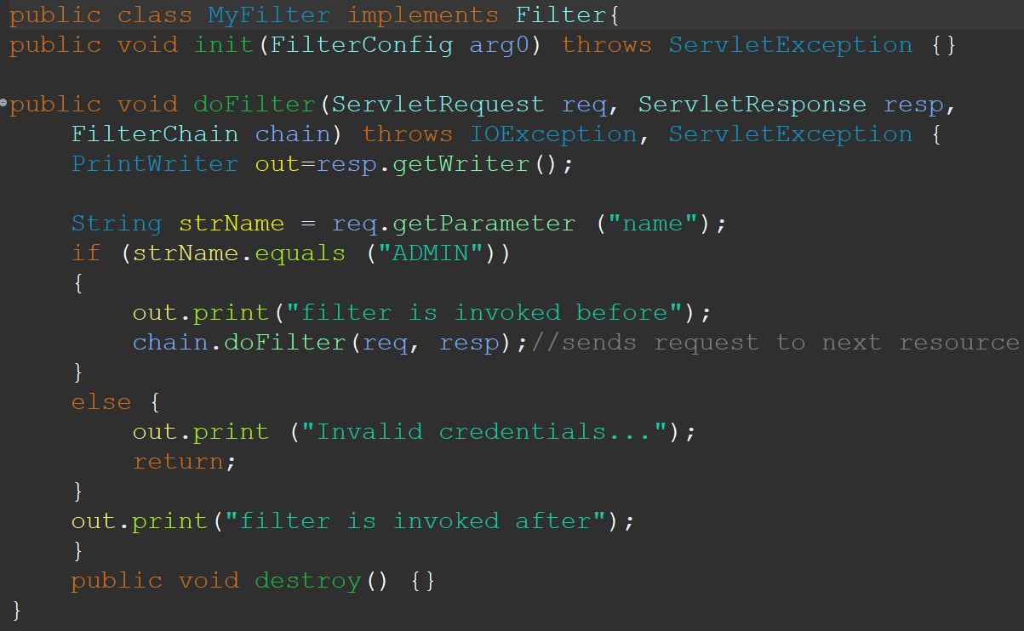
Filter java file

Slide 33
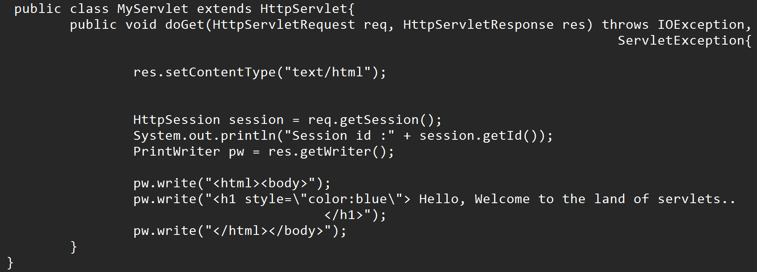
Servlet java file

Slide 34
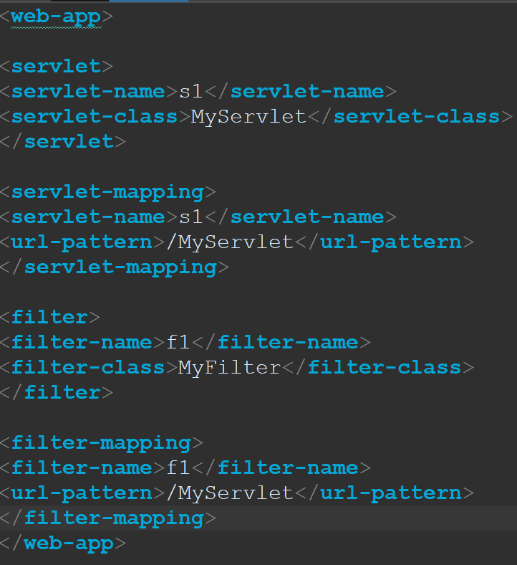
Web.xml in web-inf directory.

Slide 35
Filter Class
Povided details in previous slide

Slide 36
Configuring a Filter in the web.xml File
Povided details in previous slide

Slide 37
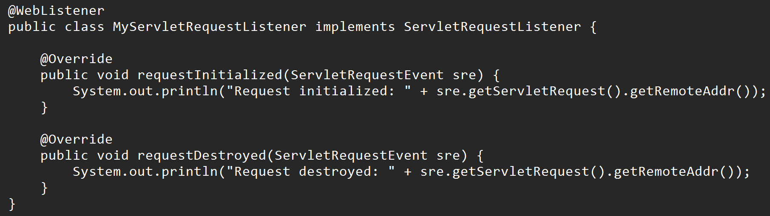
ServletRequestListener Interface
The ServletRequestListener interface is part of the Java Servlet API and is used to listen to lifecycle events of HTTP requests in a web application. It is primarily intended for developers who need to perform actions when a request is created or destroyed.The interface is defined in the javax.servlet package and has the following methods:
Methods in ServletRequestListener
void requestInitialized(ServletRequestEvent sre) : Called when an HTTP request is about to be processed by the servlet. This method can be used to initialize resources or log the start of a request.
void requestDestroyed(ServletRequestEvent sre) : Called when an HTTP request is about to go out of scope (i.e., the response has been sent back to the client). You can use this method to clean up resources (like closing database connections) or log the end of a request.

Slide 38
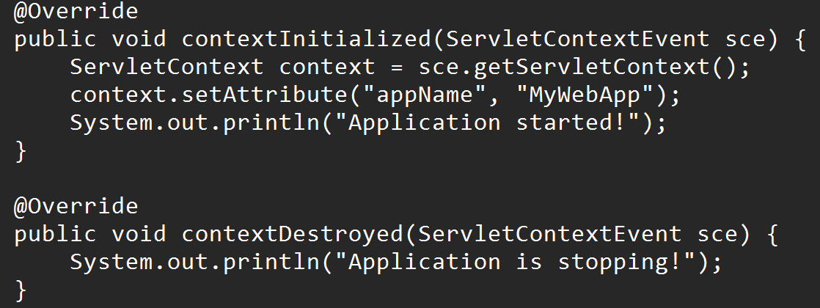
ServletContextListener Interface
An object of ServletContext is created by the web container at time of deploying the project. This object can be used to get configuration information from web.xml file. There is only one ServletContext object per web application.
The ServletContextListener interface in Java is part of the Java Servlet API and is used to listen for lifecycle events of the ServletContext. This interface is typically implemented to perform initialization and cleanup tasks for a web application. It has two methods.
contextInitialized(ServletContextEvent sce): Called when the web application is starting up. Used for initializing resources like database connections, loading configuration settings, or setting up application-wide parameters.
contextDestroyed(ServletContextEvent sce): Called when the web application is shutting down. Used for releasing resources such as closing database connections, cleaning up caches, or stopping background tasks.

Slide 39
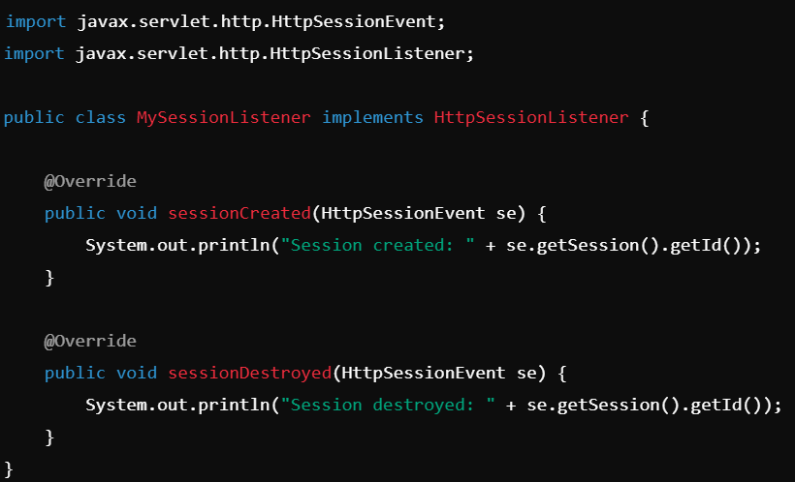
HttpSessionListener Interface
The HttpSessionListener interface is part of the Java Servlet API. It allows developers to listen for changes in the lifecycle of an HTTP session. This interface is particularly useful for tracking when sessions are created or destroyed in a web application. This interface has two methods. They are:
sessionCreated(HttpSessionEvent se): Triggered when a new HTTP session is created. Useful for initializing session-level resources or tracking session creation events.
sessionDestroyed(HttpSessionEvent se): Triggered when an HTTP session is invalidated or times out. Useful for cleaning up session-level resources or tracking session destruction events.

Slide 40
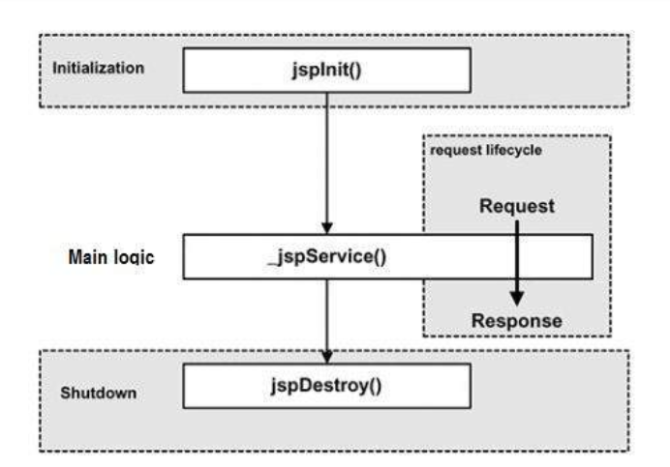
Introduction and Life Cycle of JSP
SP (JavaServer Pages) scriptlet tags allow you to include Java code directly within a JSP page. These tags are typically used to embed dynamic content and perform server-side logic. However, the use of scriptlets is generally discouraged in modern Java web applications, as they can lead to hard-to-maintain and poorly structured code. Instead, MVC frameworks like Spring MVC or JSP Expression Language (EL) are preferred.

Slide 41
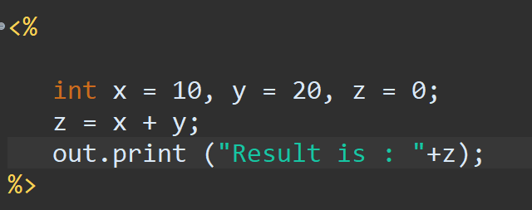
JSP Scriptlets Tags
JSP Scriptlet Tags
The main JSP scriptlet tags are:
1. Scriptlet Tag (<% ... %>):
Used to embed Java code within the JSP page.
Code inside this tag is executed when the page is processed on the server.

Slide 42
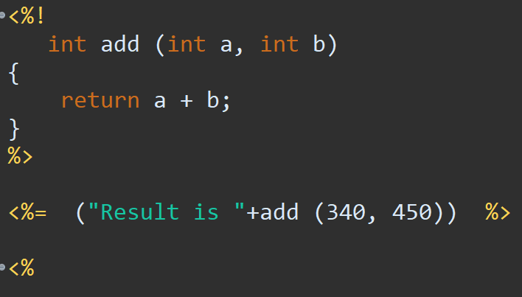
JSP Expressions Tags

Slide 43
JSP Declarations Tags
In JavaServer Pages (JSP), Declaration Tags are used to declare variables or methods that will be available to all requests for a specific JSP page. The code inside the declaration tag is placed in the _jspService() method's class definition, but outside the service method itself.

Slide 44
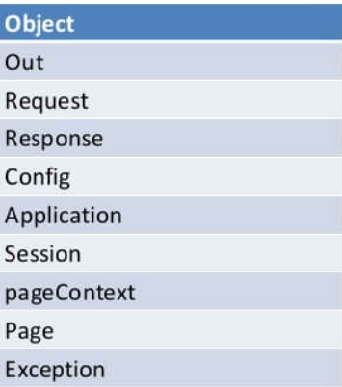
JSP Implicit Object
In Java Server Pages (JSP), implicit objects are predefined objects provided by the JSP container. These objects are automatically available in a JSP page without needing to be declared or instantiated, making it easier for developers to write server-side logic.
There are 9 implicit objects are there in JSP. They are

Slide 45
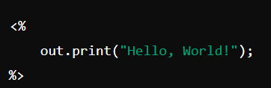
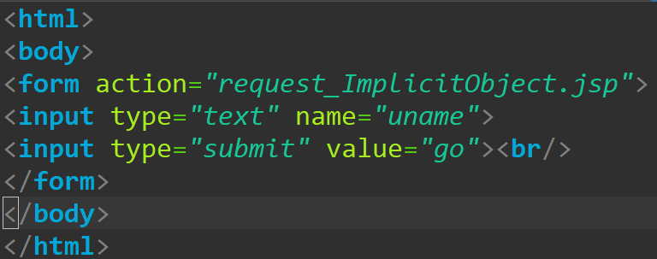
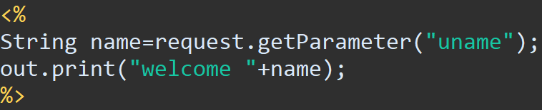
JSP Implicit Object
1. Out -->
2. request --> Request object. Using this we can get the parameters passed to the server using the method getParameter().
HTML Code: JSP Code with using requestObject.

Slide 46
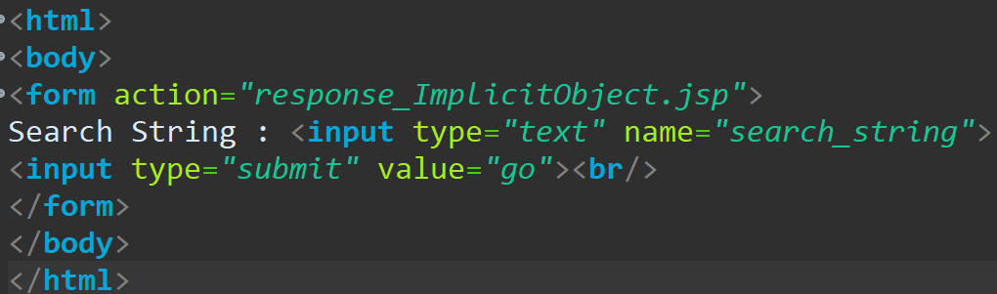
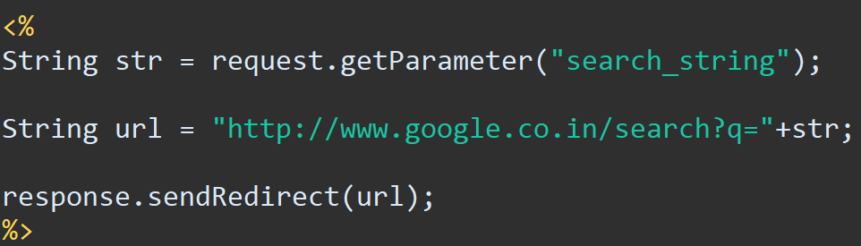
JSP Implicit Object - response
Response object --> Represents the response object, what data will be responded or returned to the client is in this object. The below given program will take the serach string and searches in the browser.
HTML Code JSP Code :

Slide 47
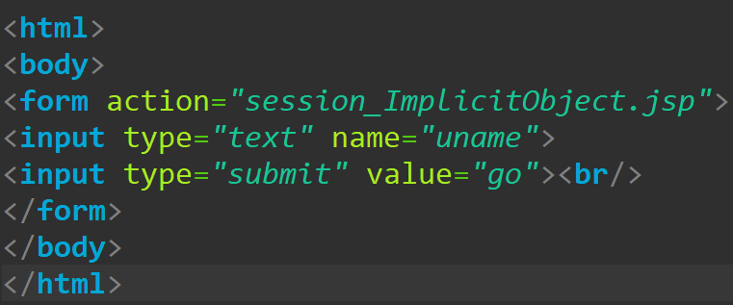
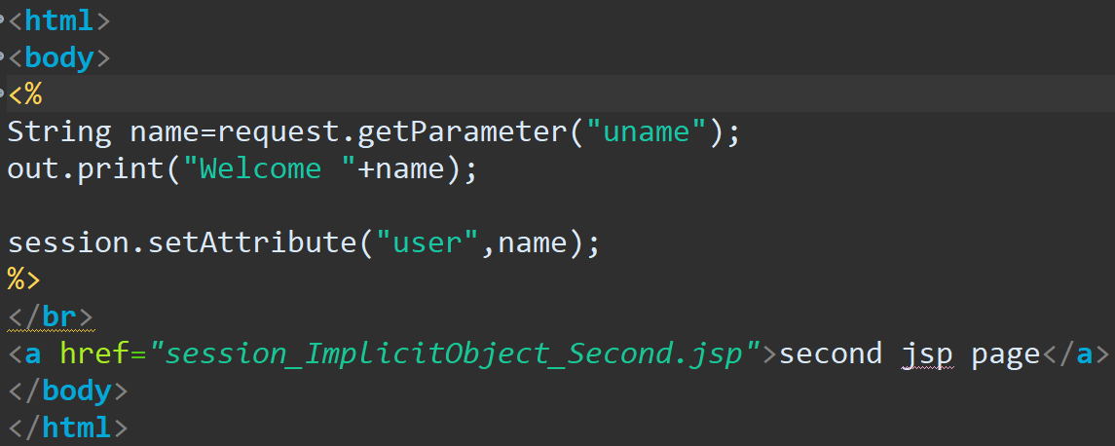
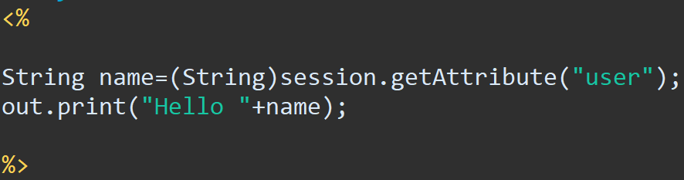
JSP Implicit Object - session
Session object : Represents the user's session, allowing data to be stored and shared across multiple requests from the same client. In the below given code, user name is taken and set in the session in the first jsp and retrieved the data from the session from the second jsp and printed.
HTML Code --> First JSP
Second jsp :

Slide 48
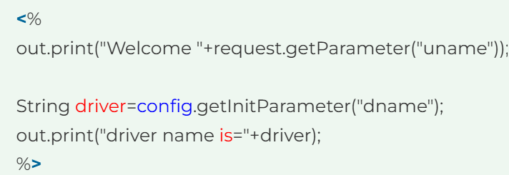
JSP Implicit Object – Application and config.
application object : Represents the application scope and is used to store data that can be shared across the entire application.
Config object : In JSP, config is an implicit object of type ServletConfig. This object can be used to get initialization parameter for a particular JSP page. The config object is created by the web container for each jsp page. Generally, it is used to get initialization parameter from the web.xml file. The following code will read dname from web.xml for this jsp page.

Slide 49
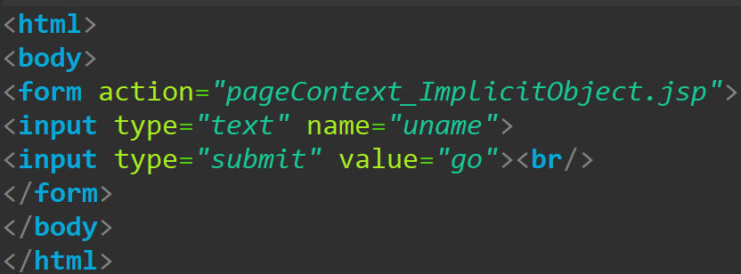
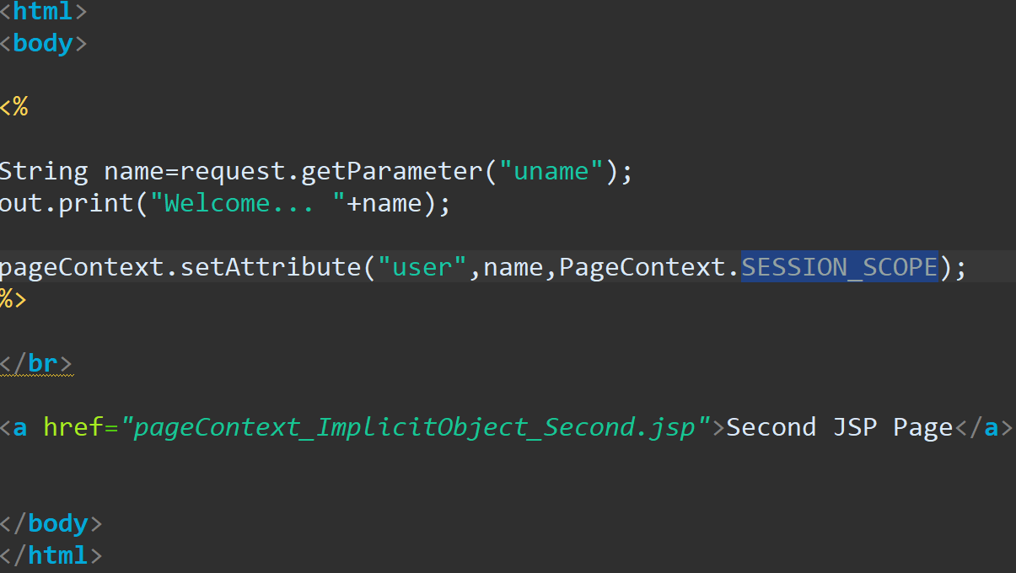
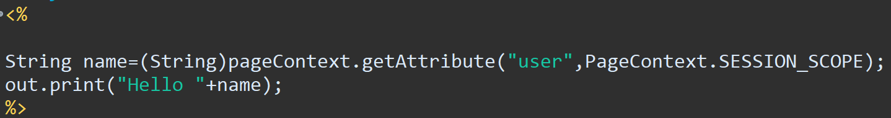
JSP Implicit Object – pageContext
Provides access to all JSP scopes (page, request, session, application) and other utility methods.
HTML code: JSP Code:
Second jsp page

Slide 50
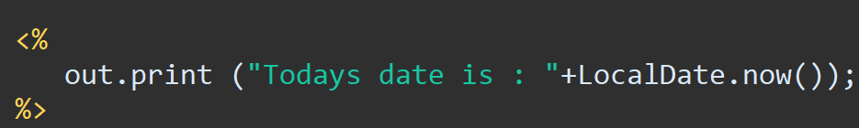
JSP Implicit Object – page object.
Page object provide information about the current page. We can import using page object also.

Slide 51


JSP Implicit Object – exception.
Provides access to all JSP scopes (page, request, session, application) and other utility methods.
Exception page :

Slide 52

JSP Action Tags
There are many JSP action tags or elements. Each JSP action tag is used to perform some specific tasks. The action tags are used to control the flow between pages and to use Java Bean. The Jsp action tags are given below.

Slide 53


JSP Action Tags – Include action tag.
First jsp file :
Second jsp file

Slide 54

JSP Action Tags – forward action tag.
Forwards the control from one jsp file to another. This jsp file will forwards the control to includeAction.jsp.

Slide 55


Forwarding Java objects to JSP
Data can be sent from servlet to a jsp.
First let us create a html file -->
On click of this hyperlink, it will
Call the servlet ForwardToJSP.
(ForwardToJsp.html)
ServletFile -->

Slide 56


Forwarding Java objects to JSP
Items.jsp -->

Slide 57

Use request, session, and application objects to store data
Create a file named : request_session_application.jsp and have the following code in it.

Slide 58
Creating custom tags with JSP 2 tag files
JSP 2.0 introduced tag files, a simple and elegant way to create reusable custom tags without writing Java code or implementing tag handler classes. Tag files are JSP fragments stored in special files with the .tag or .tagx extension.
Here's a guide on creating custom tags using JSP 2 tag files:
Steps to Create Custom Tags with JSP 2 Tag Files
1. Set Up the Tag File
Save the tag file in the WEB-INF/tags directory or any subdirectory under WEB-INF/tags.
Use the .tag extension for standard tag files or .tagx for XML-compliant tag files.
2. Write the Tag File Content
The tag file is a regular JSP file containing the logic for the tag.
Use JSP syntax and include parameters as needed.

Slide 59



Creating custom tags with JSP 2 tag files
Create a tag named greet.tag under WEB-INF\tags directory and have the following code in it.
Create a jsp file named JSP_tags_use_greet_tag.jsp and have the following code in it:

Slide 60



Customizing tag behavior with attributes
Create a jsp file and have the following code in it.
Have this code in the tag file.

Slide 61
JSTL (JSP Standard Tag Library)
The JSP Standard Tag Library (JSTL) is a collection of custom tags that simplify common tasks in Java Server Pages (JSP). It provides standard functionality such as iteration, conditional processing, internationalization, and database interaction, reducing the need for Java code in JSP pages and promoting a more declarative style.
Key Features of JSTL:
Ease of Use: Simplifies JSP development by providing standard tags for common tasks.
Cleaner Code: Encourages a separation of logic and presentation by eliminating scriptlets (Java code in JSPs).
Portability: Ensures standardization across different application servers.

Slide 62
Advantage of JSTL
JSTL (JSP Standard Tag Library) offers numerous advantages that make it a valuable tool for developing dynamic and maintainable JSP pages. Here are its key benefits:
1. Simplified Code : JSTL provides pre-defined tags for common tasks like iteration, conditional checks, and data manipulation.
2. Separation of Concerns : Encourages a clear separation of presentation logic (view) from business logic. Keeps JSP pages focused on the presentation, while Java classes handle the business logic.
3. Standardization : As a standardized library, JSTL ensures consistent behavior across different Java EE-compliant application servers. Developers can rely on a uniform syntax and functionality.
4. Improved Maintainability
5. Reusability : JSTL tags are reusable and can handle common tasks across multiple JSPs, reducing code duplication.
6. Internationalization and Localization : The fmt tag library simplifies handling of internationalization (i18n) tasks
7. Compatible with EL (Expression Language)
8. Reduced Error-Prone Code : Replacing Java scriptlets with JSTL tags minimizes the risk of syntax and runtime errors caused by improper Java code.

Slide 63

Types of Tags
Here is the list of possible tags in JSTL

Slide 64

Core and Formatting Tags

Slide 65

Core and Formatting Tags

Slide 66

Types of Tags
Here is the list of possible tags in JSTL

Slide 67


Types of Tags

Slide 68


Types of Tags

Slide 69
Asynchronous Servlet Mechanism
The Asynchronous Servlet Mechanism in Java allows servlets to handle requests asynchronously, freeing up server threads to process other tasks while waiting for long-running operations (e.g., database queries, external API calls) to complete. This is especially useful in modern web applications where scalability and responsiveness are critical.
Asynchronous Processing: Requests are processed in a non-blocking manner. The servlet thread returns to the container after starting the asynchronous process, allowing the server to handle other requests.

Slide 70


Slide 71

JavaScript to Send an HTTP Request from a Client
To send an HTTP request in JavaScript for asynchronous web applications, you can use one of the following approaches: (1) Using fetch API (2) Using XMLHttpRequest -

Slide 72
JavaScript to Send an HTTP Request from a Client
To send an HTTP request in JavaScript for asynchronous web applications, you can use one of the following approaches: (1) Using fetch API (2) Using XMLHttpRequest -

Slide 73

JavaScript to Send an HTTP Request from a Client
XMLHttpRequest is a legacy way of performing the same task.

Slide 74
Asynchronous web applications and Web application security - HTTP Response Entirely in JavaScript
Asynchronous web applications enable the client-side JavaScript to handle HTTP responses dynamically, updating the user interface (UI) without requiring a full page reload. This method is commonly seen in Single Page Applications (SPAs) where all interactions happen on the client side after the initial page load.
In such applications, the HTTP response is typically a JSON object, which JavaScript processes and uses to update the page content dynamically.
As discussed previously, Fetch API is used to get the data and also XMLHttpRequest() is also used to get the data asynchronously.

Slide 75
Combining These Techniques to Create the Effect of Server-push.
In asynchronous web applications, you can create the effect of server-push, where the server sends updates to the client without the client needing to request them repeatedly. This can be achieved using technologies like WebSockets, Server-Sent Events (SSE), and long polling. Below is a breakdown of these techniques and how they can be used to create a server-push effect.
1. WebSockets (Full-Duplex Communication)
WebSockets provide a full-duplex communication channel over a single, long-lived connection, allowing the server to send data to the client in real-time without needing to poll.

Slide 76


Web socket code

Slide 77

Server Sent Events (SSE)
2. Server-Sent Events (SSE) :SSE is a one-way communication channel where the server sends events to the client over a single HTTP connection. SSE is simpler than WebSockets for cases where the server only needs to send data to the client (i.e., no full-duplex communication is needed).

Slide 78
Server Sent Events (SSE)
2. Server-Sent Events (SSE) :SSE is a one-way communication channel where the server sends events to the client over a single HTTP connection. SSE is simpler than WebSockets for cases where the server only needs to send data to the client (i.e., no full-duplex communication is needed).
3. Long Polling : Long polling is a technique where the client sends a request to the server and waits for a response. The server holds the request open until new data is available, then responds to the client. The client immediately sends a new request after receiving the response, thus maintaining a continuous connection.

Slide 79
Role of the container in Security.
In web application security, containers play a crucial role in isolating applications and services to enhance security. Here's a breakdown of the role of containers in securing web applications:
1. Isolation : Process Isolation: Containers provide a level of isolation between the application and the host system, preventing unauthorized access between applications running in separate containers. This reduces the risk of malicious attacks spreading from one service to another.
2.Consistency and Environment Control : Containers help ensure that applications run in consistent environments across different stages of deployment (development, testing, production), mitigating issues related to inconsistent configurations, which can introduce vulnerabilities.
3. Least Privilege : Containers allow you to apply the principle of least privilege by restricting the permissions and capabilities available to the processes running within them. For example, you can prevent containers from accessing sensitive parts of the file system or limit their network capabilities.
4. Immutability : Containers are typically built as immutable objects, meaning they cannot be altered once they are deployed. If a vulnerability is found, the container image can be updated and redeployed rather than relying on modifying running instances
5. Runtime Security : During the container runtime, security monitoring tools can track the behavior of containers for suspicious activities, such as unauthorized file modifications, network traffic anomalies, or attempts to escalate privileges.

Slide 80
Describe and implement four authentication models.
In web application security, authentication is a critical mechanism for ensuring that only authorized users can access specific resources. Various authentication models can be implemented depending on the system's security needs. Here are four common authentication models:
1. Basic Authentication : Basic Authentication is one of the simplest forms of authentication. It requires users to send their credentials (username and password) in the HTTP request header and it is authenticated..
2. Session-based Authentication : Session-based authentication involves creating a session for a user after a successful login. The server stores a session ID, and the client (browser) stores it in a cookie. After successful login, the server generates a session ID and stores it on the server-side. The session ID is sent to the client as a cookie, which is automatically included in subsequent requests. Session management can involve setting expiration times and securing the session with techniques like CSRF protection.

Slide 81
Describe and implement four authentication models.
3. Token-based Authentication (JWT) : Token-based authentication, especially using JSON Web Tokens (JWT), is a stateless authentication mechanism where the server doesn't store sessions. Instead, the server issues a token containing the user's credentials or claims. After a successful login, the server generates a JWT token, which includes user information (like user ID, roles, and expiration time). The client stores the JWT token and includes it in the Authorization header as Bearer <token> in subsequent requests. JWT is typically used in RESTful APIs.
4. OAuth 2.0 Authentication : OAuth 2.0 is a widely used authorization framework that allows third-party services to access resources on behalf of the user. It is commonly used for "Login with Google" or "Login with Facebook" scenarios.

Slide 82
Encryption between a web application and the client browser.
Encryption Between a Web Application and the Client Browser
Secure encryption between a web application and the client browser is achieved using HTTPS, which combines HTTP with Transport Layer Security (TLS).
TLS ensures that all data exchanged is encrypted, preventing interception or tampering during transit by malicious actors (e.g., Man-in-the-Middle attacks).
The encryption process begins with a TLS handshake, where the client and server exchange keys to establish a secure connection.
During the handshake, the server provides an SSL/TLS certificate, proving its identity and enabling the client to verify its authenticity.
Once the handshake is complete, a session key is generated to encrypt all subsequent communication between the browser and the application.
To enforce encryption, web servers should use strong ciphers like AES (Advanced Encryption Standard) and enable forward secrecy to enhance security.
Modern browsers display a padlock icon in the address bar for HTTPS connections, reassuring users of the secure channel.
Certificates issued by trusted Certificate Authorities (CAs) ensure that users connect to the intended application, mitigating phishing risks.
It's essential to configure the server to redirect HTTP traffic to HTTPS, ensuring encryption for all communications.
For added security, HTTP Strict Transport Security (HSTS) can be implemented, forcing the browser to always use HTTPS for the web application.

Slide 83
Role of JAAS in pluggable/extensible authentication for web applications.
Java Authentication and Authorization Service (JAAS) provides a flexible and pluggable framework for authentication and authorization in Java-based web applications.
It allows developers to integrate custom or third-party authentication mechanisms without modifying the core application code by abstracting authentication logic.
JAAS achieves this through LoginModules, which are configurable components that perform authentication based on credentials (e.g., username/password, biometrics, or tokens).
By supporting multiple authentication schemes, JAAS enables extensibility, allowing applications to adapt to evolving security requirements.
Additionally, JAAS integrates seamlessly with Java EE containers, making it suitable for securing web applications by managing user identity and roles.

Slide 84
Thank you...

